Slide 1
Exploring Dynamical Bifurcations in Fluid Flows Using Digital Image Correlation
Daniel Borrero
Department of Physics
Willamette University
vBFY 2021

Slide 2
Flow Instabilities
Fluid flows often undergo sudden qualitative changes in behavior as parameters are varied. E.g., here, the flow between coaxial rotating cylinders undergoes a transition to waves. These transitions can often be understood using the framework of bifurcation theory.

Slide 3
Linear Dynamics in 1D
fixed point
Systems evolve to equilibrium states ($\dot{x}=0$)

Slide 4
Nonlinear Dynamics in 1D
Nonlinearity allows for multiple solutions!

Slide 5
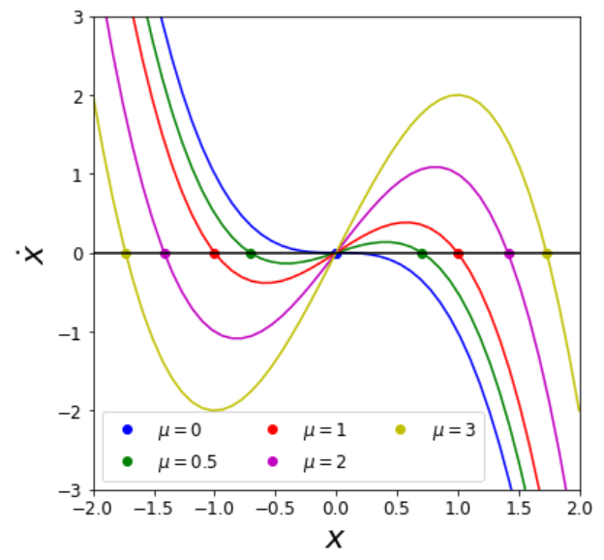
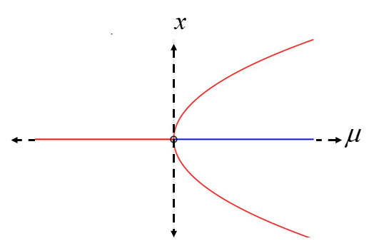
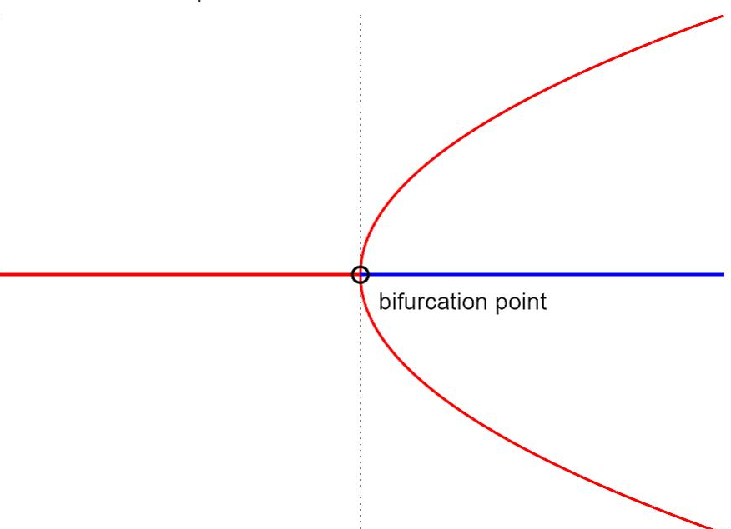
Bifurcations
$$\dot{x}=μx−x^{3}=x\left(μ−x^{2}\right)$$
$→x^{∗}=0$ or $x^{∗}=±\sqrt{μ}$
$$μ$$
$$x^{∗}$$
New solutions
at $μ_{c}$
$$\dot{x}$$
$$x$$
$$x$$
$x^{∗}\sim \sqrt{μ−μ_{c}}$ scaling of amplitude of new solution is common
The number and stability of solutions varies as parameters are changed.

Slide 6
The Navier-Stokes Equations
NONLINEAR!
The NSE are essentially Newton’s 2nd Law for fluids. Importantly, they are nonlinear!

Slide 7
Reynolds Number
It is convenient to rewrite the NSE in dimensionless form. Let
then
where

Slide 8
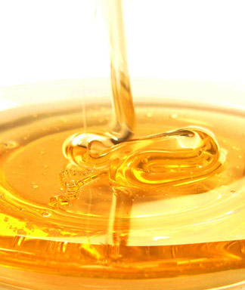
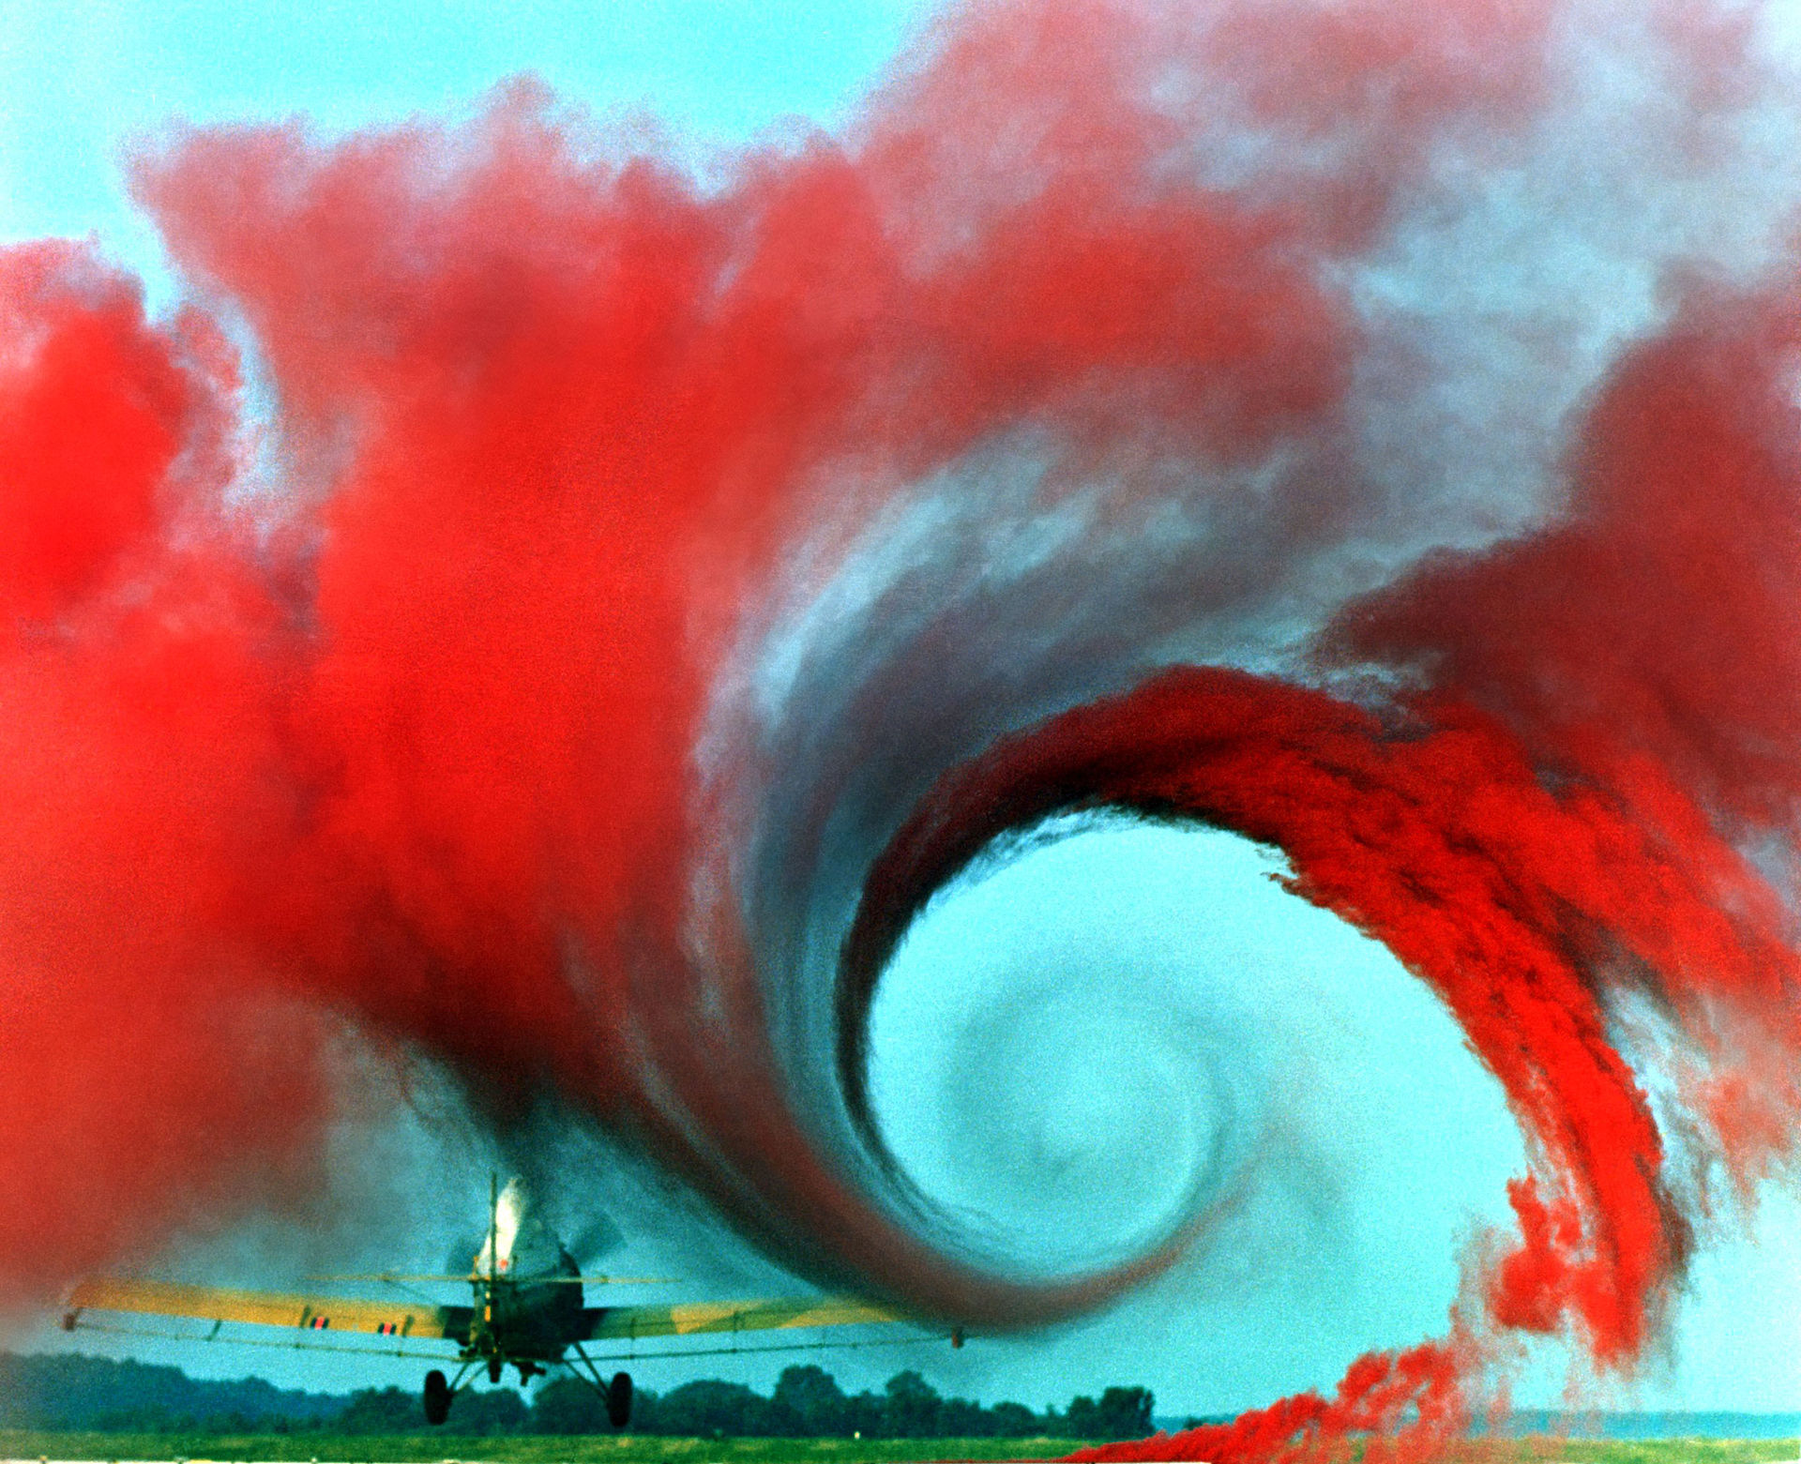
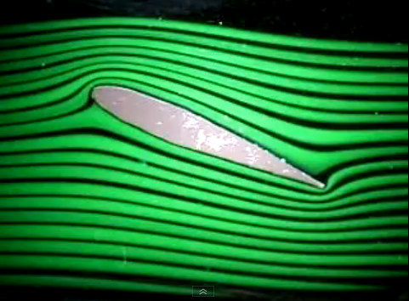
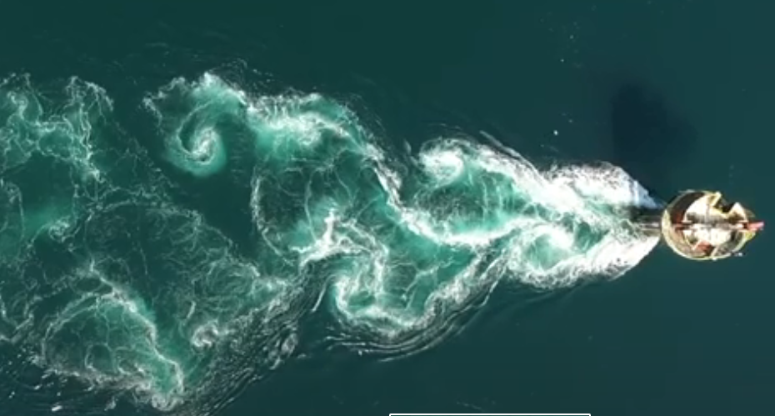
Reynolds Number
Image by Stock Exchange
Image by NASA
Image courtesy of D Webster and CEE3440
Image by A. Nimmo-Smith (YouTube)
Low $Re$ High $Re$

Slide 9
Fluid Flows as Dynamical Systems
v_{11,x}
v_{11,y}
v_{12,x}
v_{12,y}
…
v_{21,x}
v_{21,y}
v_{22,x}
v_{22,y}
…
v_{31,x}
v_{31,y}
v_{32,x}
v_{32,y}
…
Image by B. Suri
Fluid flows can be thought of a dynamical systems evolving in a very high-dimensional (formally infinite dimensional) state space.

Slide 10
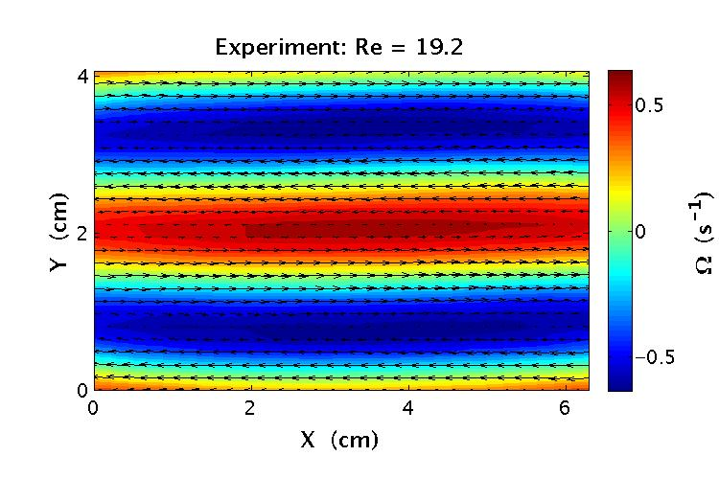
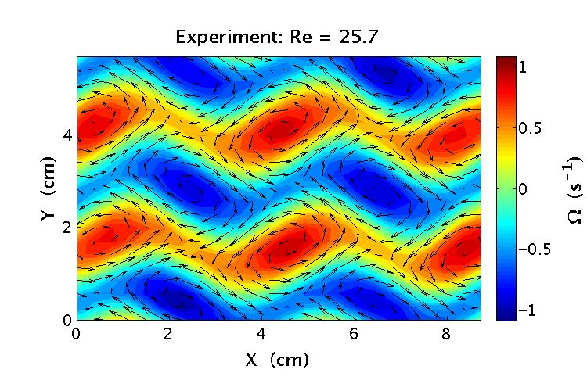
The Transition to Turbulence
Increasing $Re$
As $Re$ increases, flows become more complex through a series of discrete bifurcations that break the spatial and temporal symmetries of the flow. Often these bifurcations occurs on a low dimensional manifold embedded in the full high-dimensional state space, so low dimensional dynamical systems theory can be used.
$$x^{∗}$$
$$Re$$

Slide 11
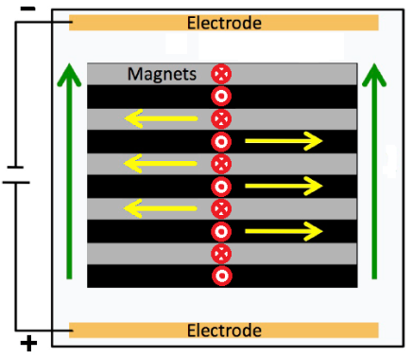
An Electromagnetically-Driven, Quasi-2D Flow Cell
I
N S N S N
S N S N S
N S N S N
S N S N S
N S N S N
Side View
Electrolyte
Top View
Materials list here.
Digilov, R.M., 2007. AJP, 75(4), pp.361-367.
Kelley, D.H. and Ouellette, N.T., 2011. AJP, 79(3), pp.267-273.
Schatz, M.F. et. al., 2013. Materials from Hands-on Research in Complex Systems School (link 1, link 2)

Slide 12
Pictures of Setup
DC Power Supply
LED lighting
(DC powered to reduce flicker)
Copper electrodes
Acrylic tray
(bottom painted black for contrast)
Leveling mount
Thumb screws
(Allow system to be leveled)
Non-magnetic surface
(Magnets tend to fly onto optical tables and shatter)

Slide 13
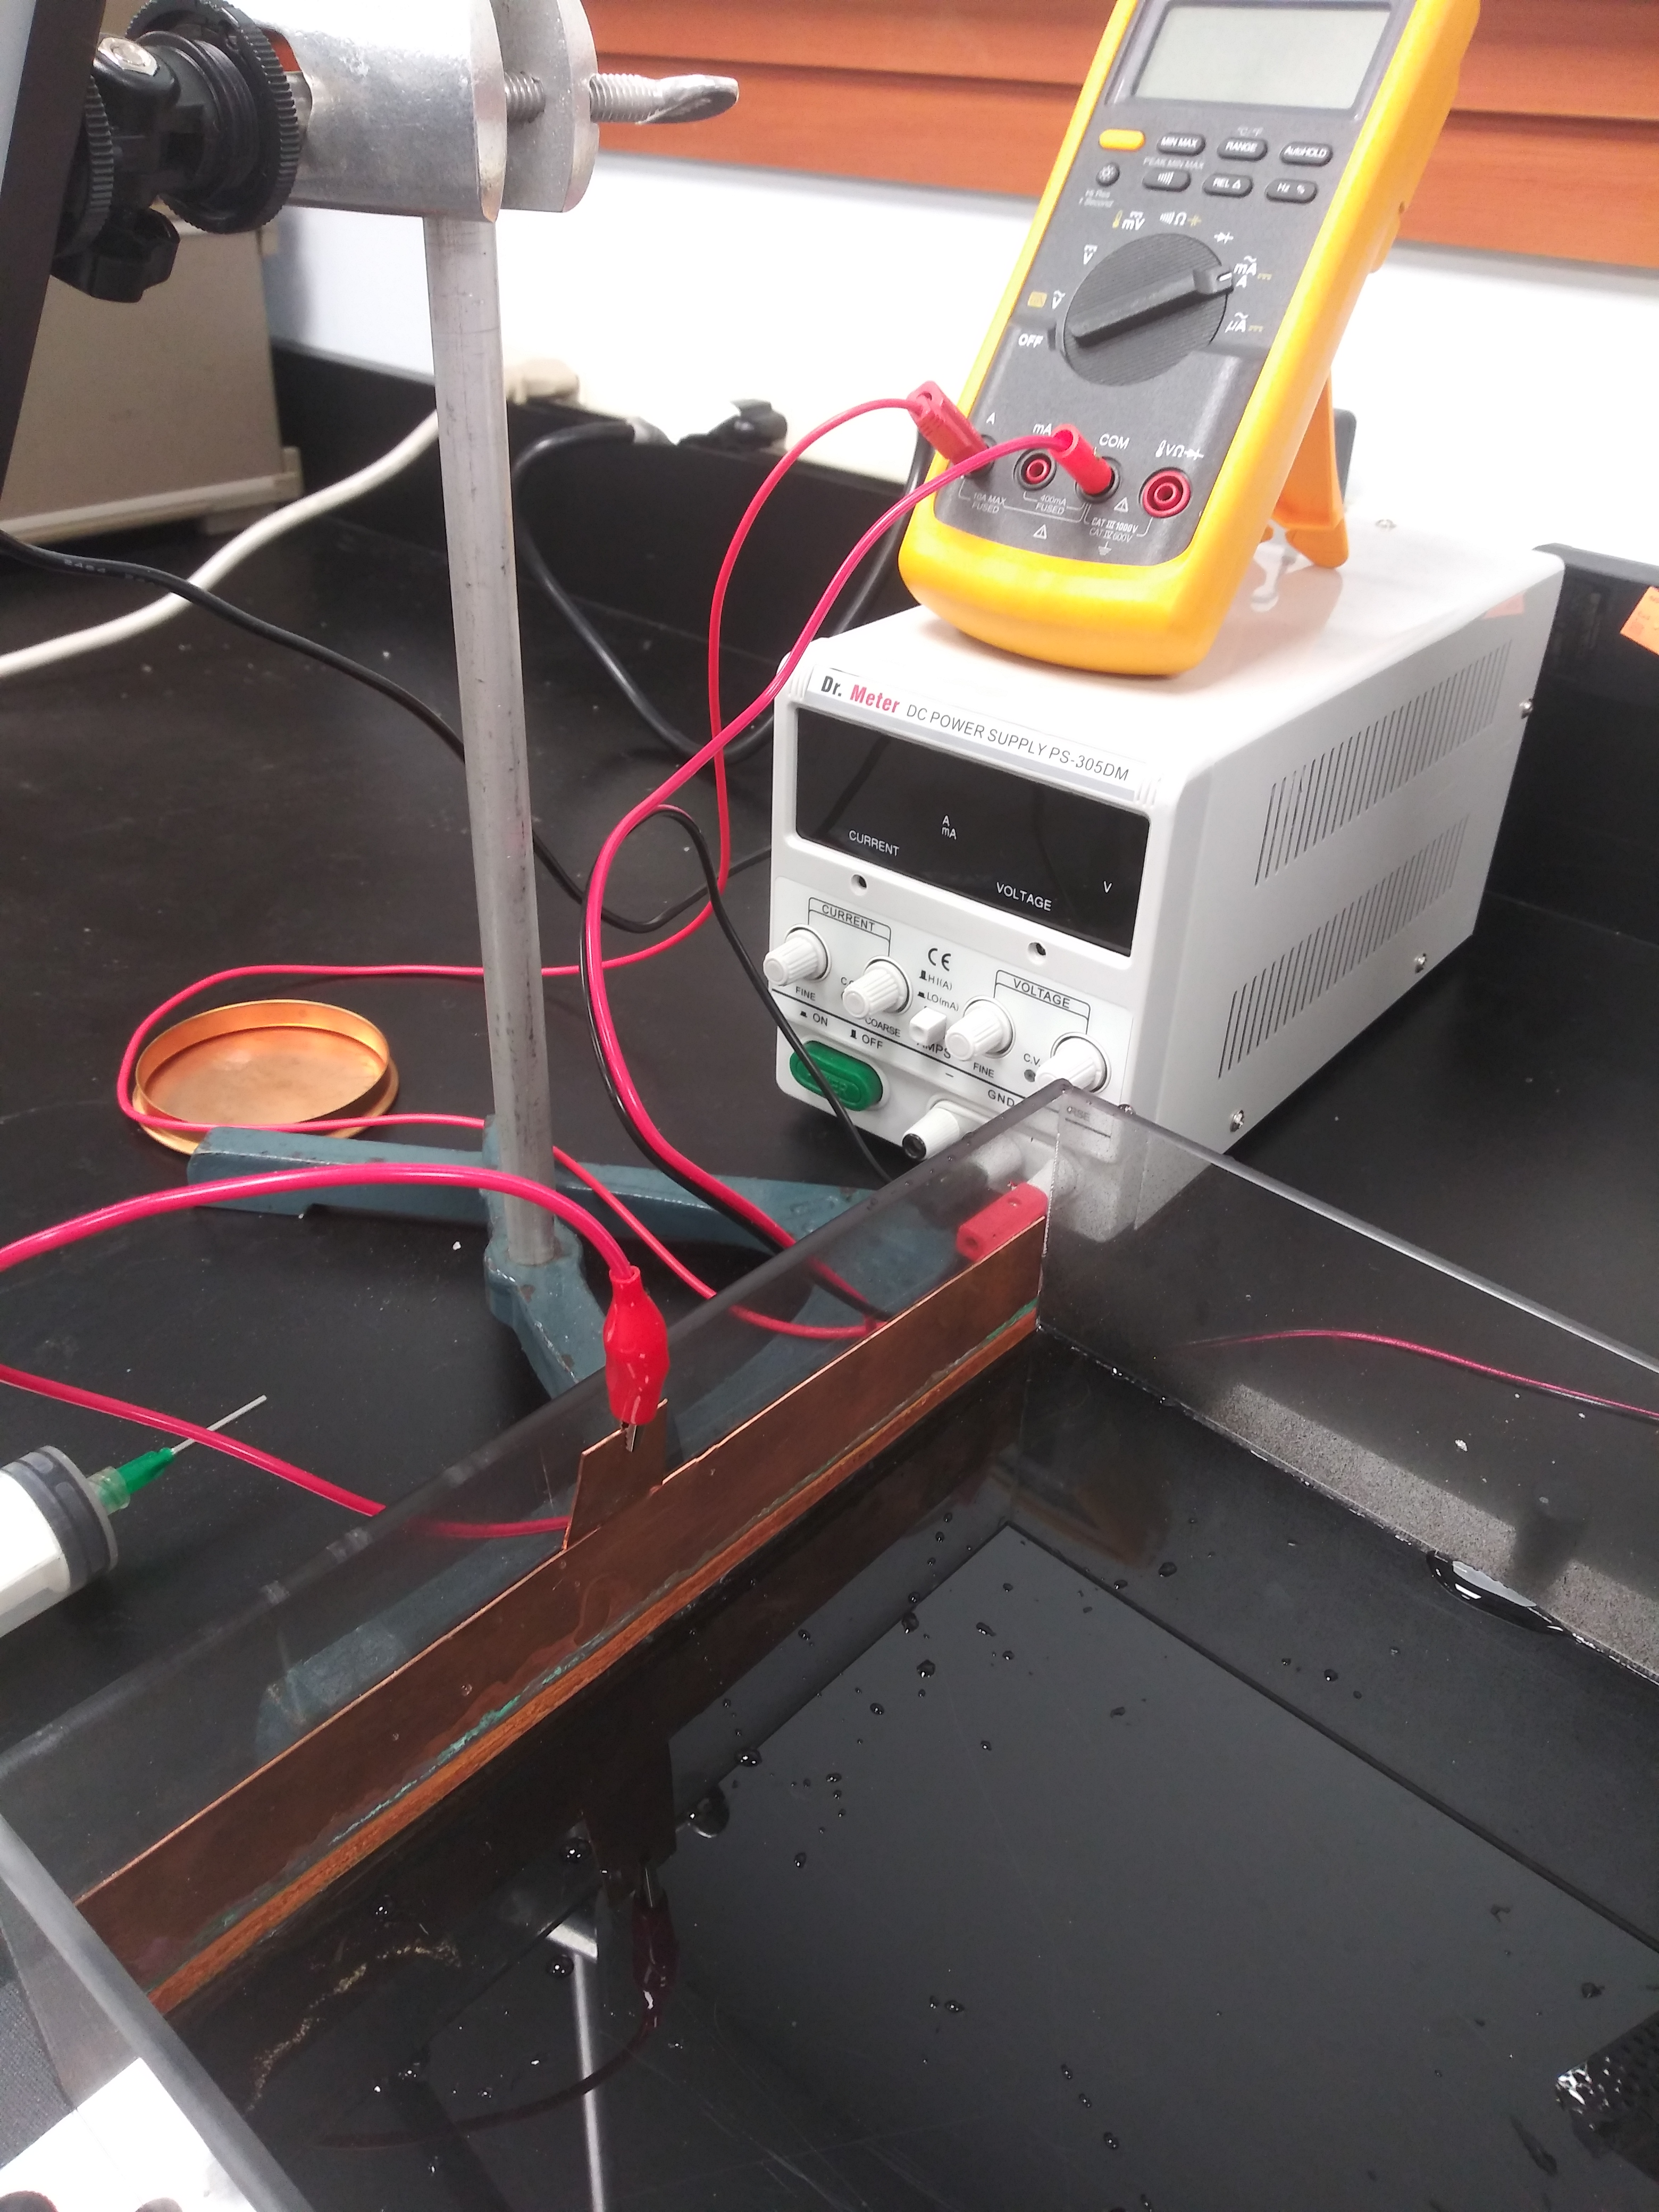
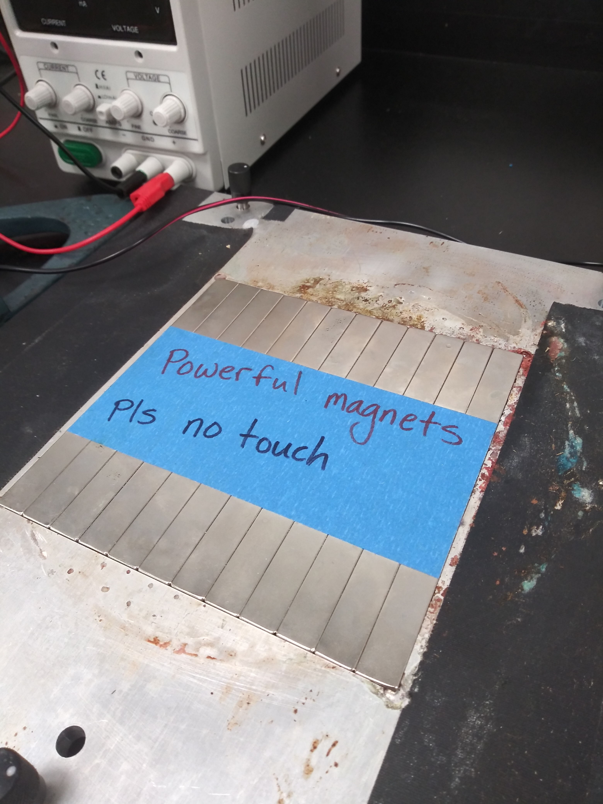
Pictures of Setup
Slot on leveling mount so magnets are flush
Adjustable DC supply (up to 30 V)
N
S
N
S
N
S
N
S
N
Magnets alternate polarities
S
Tabs on electrodes to connect power supply
N
S

Slide 14
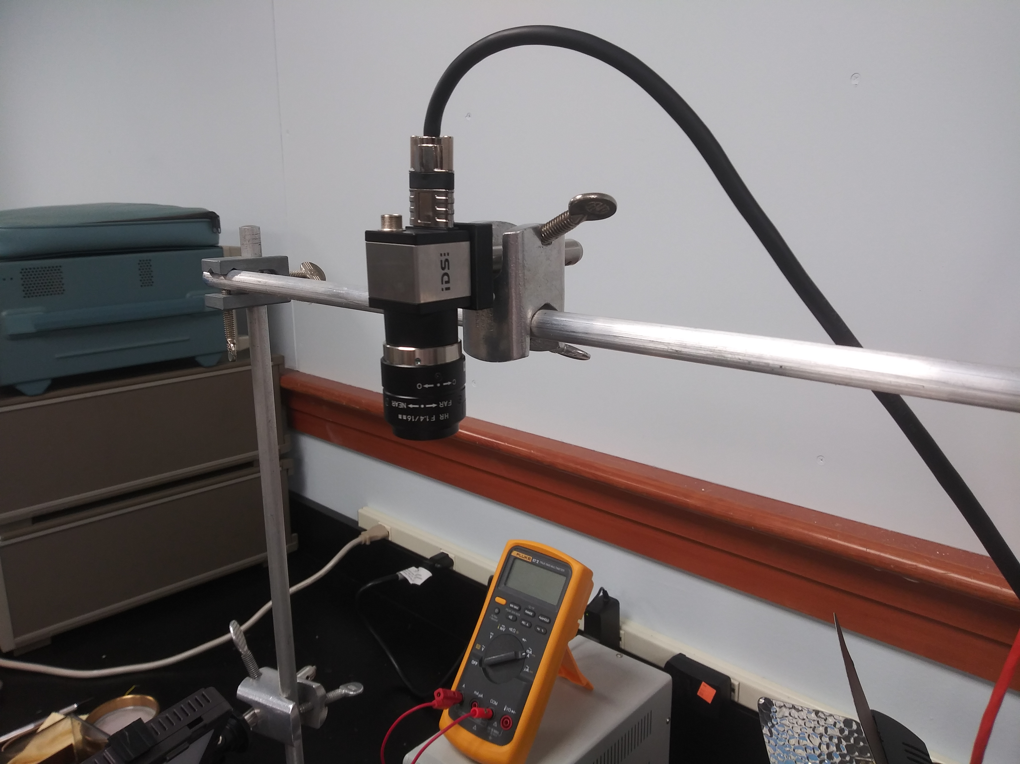
Pictures of Setup
Camera views system from above

Slide 15
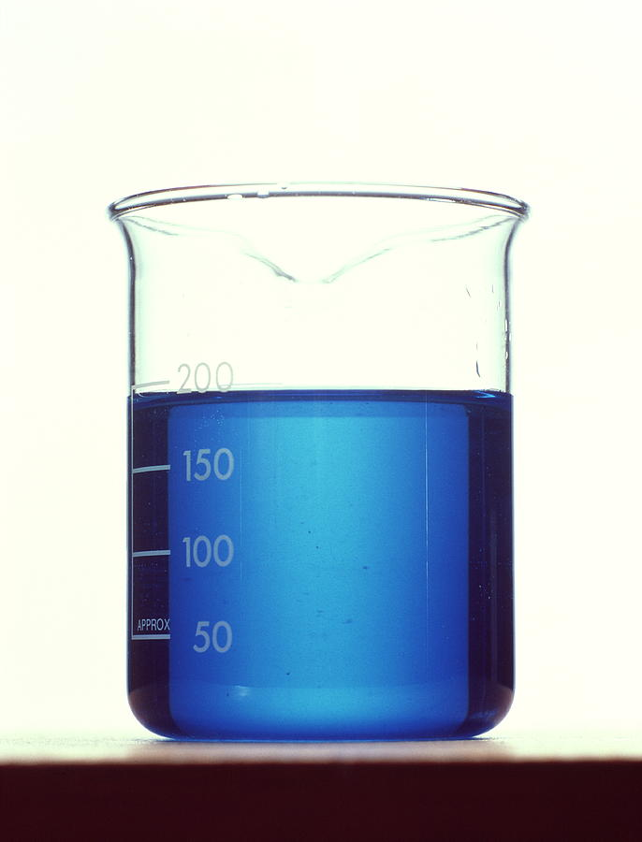
Working fluid
The working fluid consists of:
2.4 L water
600g CuSO₄$⋅$(5H₂O)
1.36 L glycerol.
This makes about 1 gallon solution with a kinematic viscosity of $ν≈$ 4.9 cSt and a density of $ρ≈$1.2 g/mL at room temperature. Dissolve in CuSO₄ in water and filter out impurities with coffee filter before mixing with glycerol to save time.
Fluid depth in tray should be around 5 mm.
Note: While not particularly dangerous, copper sulfate is harmful to aquatic life and should be disposed of properly.

Slide 16
Flow Visualization
The flow can be visualized by sprinkling small particles on the surface. Glass bubbles used for reflective paint filler work well. Ideally, flow will be uniformly seeded and illuminated and images will have strong contrast between particles and dark background.

Slide 17
Flow Visualization
Note non-uniform lighting here. This is not ideal.
Note some particles are not moving. This means they have sunk to the bottom. This is not ideal.
Note particles have clumped. This is not ideal. Clumping can be minimized by adding a drop of dish soap to solution.
Sample data is available here (good) and here (not so good).

Slide 18
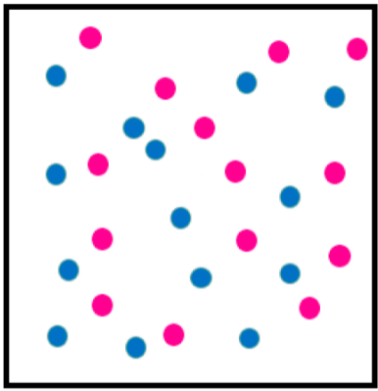
Particle Tracking Velocimetry
Now that we have a video of the flow, how do we quantify it?
A natural approach is to measure the displacement of individual particles between frames.
Together with the frame rate, this allows us to get measurements of flow velocities.
?
This approach gets tricky at high particle densities and thus limits data density. Data is also on an unstructured grid making analysis (e.g., evaluating spatial derivatives) more difficult.

Slide 19
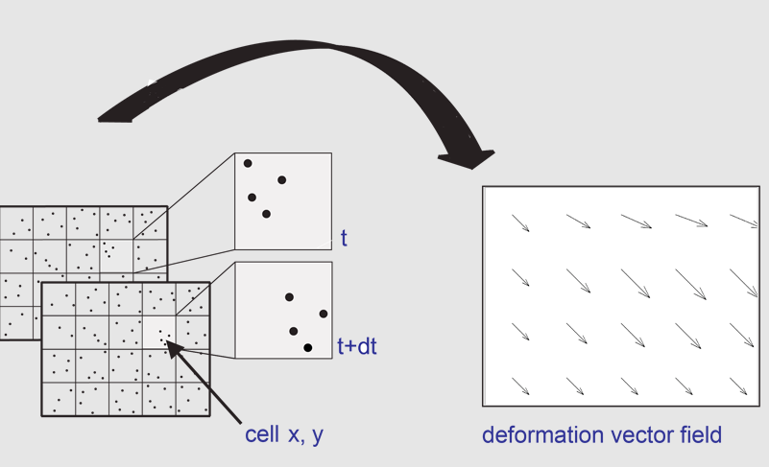
Digital Image Correlation
Digital Image Correlation (DIC) is a technique used to measure changes in images by looking at cross-correlation between images.
By breaking up particle images into small interrogation volumes and performing DIC, we can measure the displacement field and compute the local flow velocity.
This technique is called particle image velocimetry or PIV.
displacement field

Slide 20
Digital Cross-Correlation
Most likely displacement
$$I_{1}$$
$$I_{2}$$
$$R\left(Δx,Δy\right)$$
$$Δx$$
$$Δy$$
$$R\left(Δx,Δy\right)=\frac{1}{M×N} \sum_{x=1}^{M}{\sum_{y=1}^{N}{I_{1}\left(x,y\right)I_{2}(x+Δx},y+Δ y)}$$
The correlation function $R$ takes one image, shifts it, multiplies it pixel-by-pixel it with another, and adds up the result over all pixels. If the shifted images overlap, $R$ is large. By trying multiple shifts, we can find the mostly likely displacement between images.

Slide 21
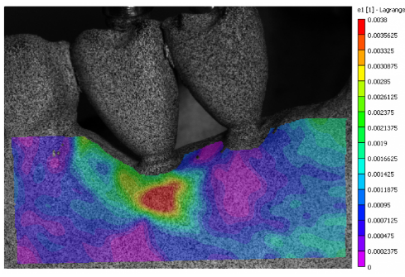
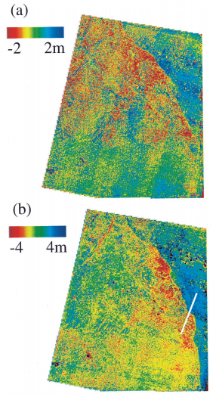
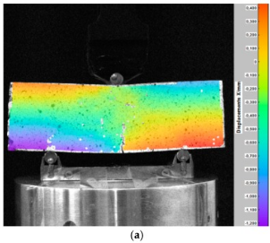
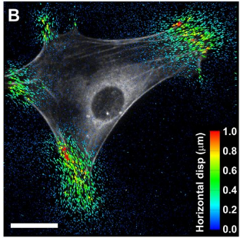
Applications of DIC
Biomechanics
Seismology
Strain field in a model mandible during simulated chewing.
East-west displacement of ground after earthquake
Civil Engineering
Cell Biology
Deformation of rock sample under 3-point load
Measurement of forces acting on a cell as it adheres to soft substrate

Slide 22
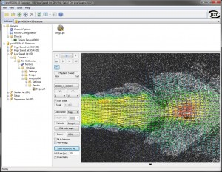
PIV Packages
Open source:
OpenPIV (Python-based)
PIVlab (Matlab-based)
JPIV (Java)
ImageJ PIV plugin
Commercial:
DaVis
TSI PIV

Slide 23
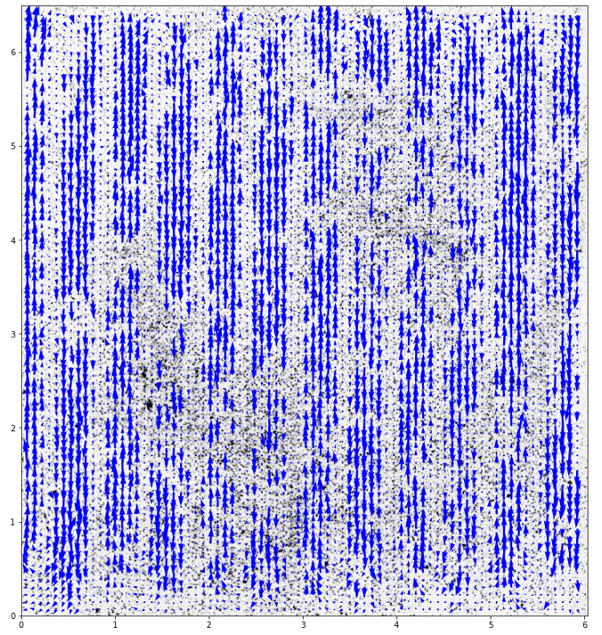
Data Analysis and Results
Achieving high quality data requires some care and experimentation with image acquisition, lighting, seeding density, and processing parameters.
See Jupyter notebook here for processing workflow.

Slide 24
Data Analysis and Results
$\sim \sqrt{Re−{Re}_{c}}$ scaling!
$$U_{x, rms} [{cm}/s]$$
$Re=\frac{U_{rms}L}{ν}$
Data from Kelley, D.H. and Ouellette, N.T., 2011. AJP, 79(3), pp.267-273.

Slide 25
References
Kelley, D.H. and Ouellette, N.T., 2011. “Using particle tracking to measure flow instabilities in an undergraduate laboratory experiment”. American Journal of Physics, 79(3), pp.267-273.
Schatz, M.F., Borrero, D., Suri, B., and Tithof, J., 200-2014. Materials from Hands-on Research in Complex Systems School (link 1, link 2)
Digilov, R.M., 2007. “Making a fluid rotate: Circular flow of a weakly conducting fluid induced by a Lorentz body force.” American Journal of Physics, 75(4), pp.361-367.
Strogatz, S.H., 2015. Nonlinear Dynamics and Chaos. Boca Raton: CRC Press.
Batchelor, G.K., 200. An Introduction to Fluid Mechanics. Cambridge: Cambridge University Press.
Boffetta, G. and Ecke, R.E., 2012. “Two-dimensional turbulence.” Annual Review of Fluid Mechanics, 44, pp.427-451.
Adrian, R. and Westerweel, J., 2011. Particle Image Velocimetry. Cambridge: Cambridge University Press.
Raffel, M. et al, 2019. Particle Image Velocimetry: A Practical Guide. Berlin: Springer.

