Slide 1
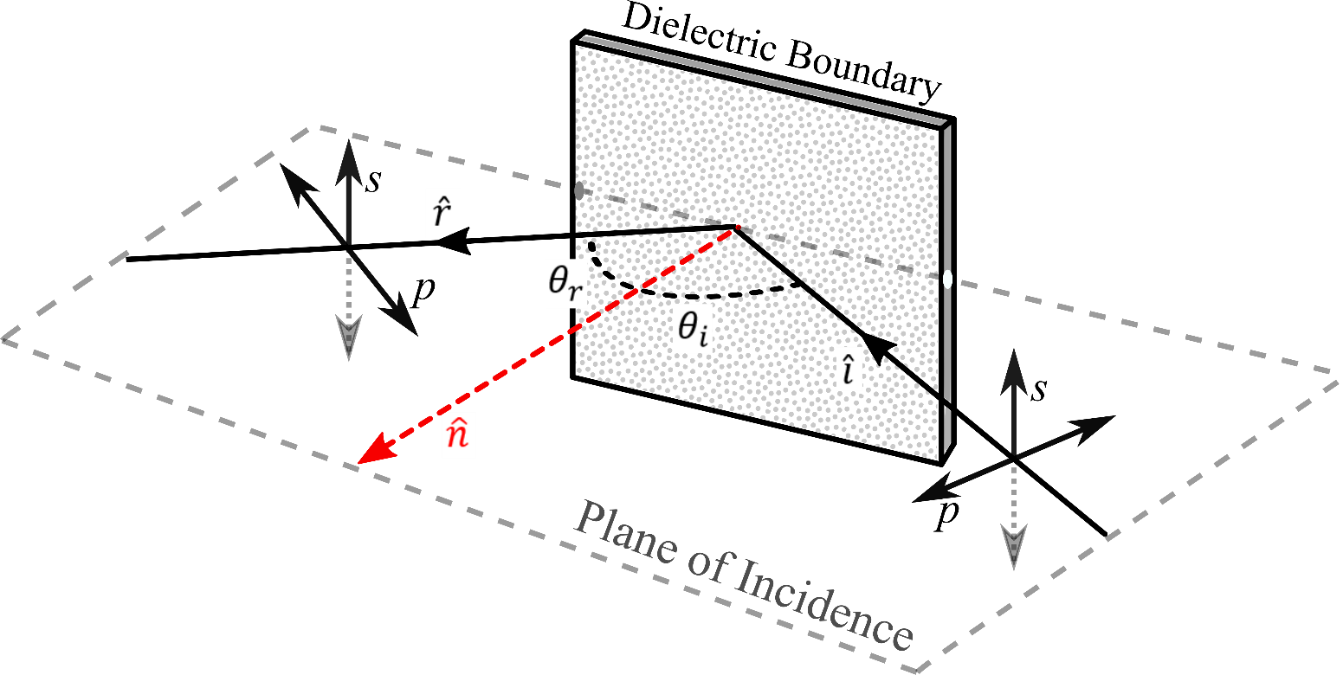
The Fresnel Equations - Measurements and Analysis
A vBFY Workshop, July 29, 2021
Prof. Michael Braunstein
Physics, Central Washington University
michael.braunstein@cwu.edu

Slide 2
Context: Advanced Lab – Polarization Unit
Working hypothesis:
polarization presents a significant and easily neglected conceptual challenge
Optical, plane-wave, electromagnetic radiation
Advanced Lab polarization unit:
Malus’ law
λ/2 plate
Birefringence
Fresnel equations
Faraday rotation
Braunstein, vBFY, 7/29/2021

Slide 3
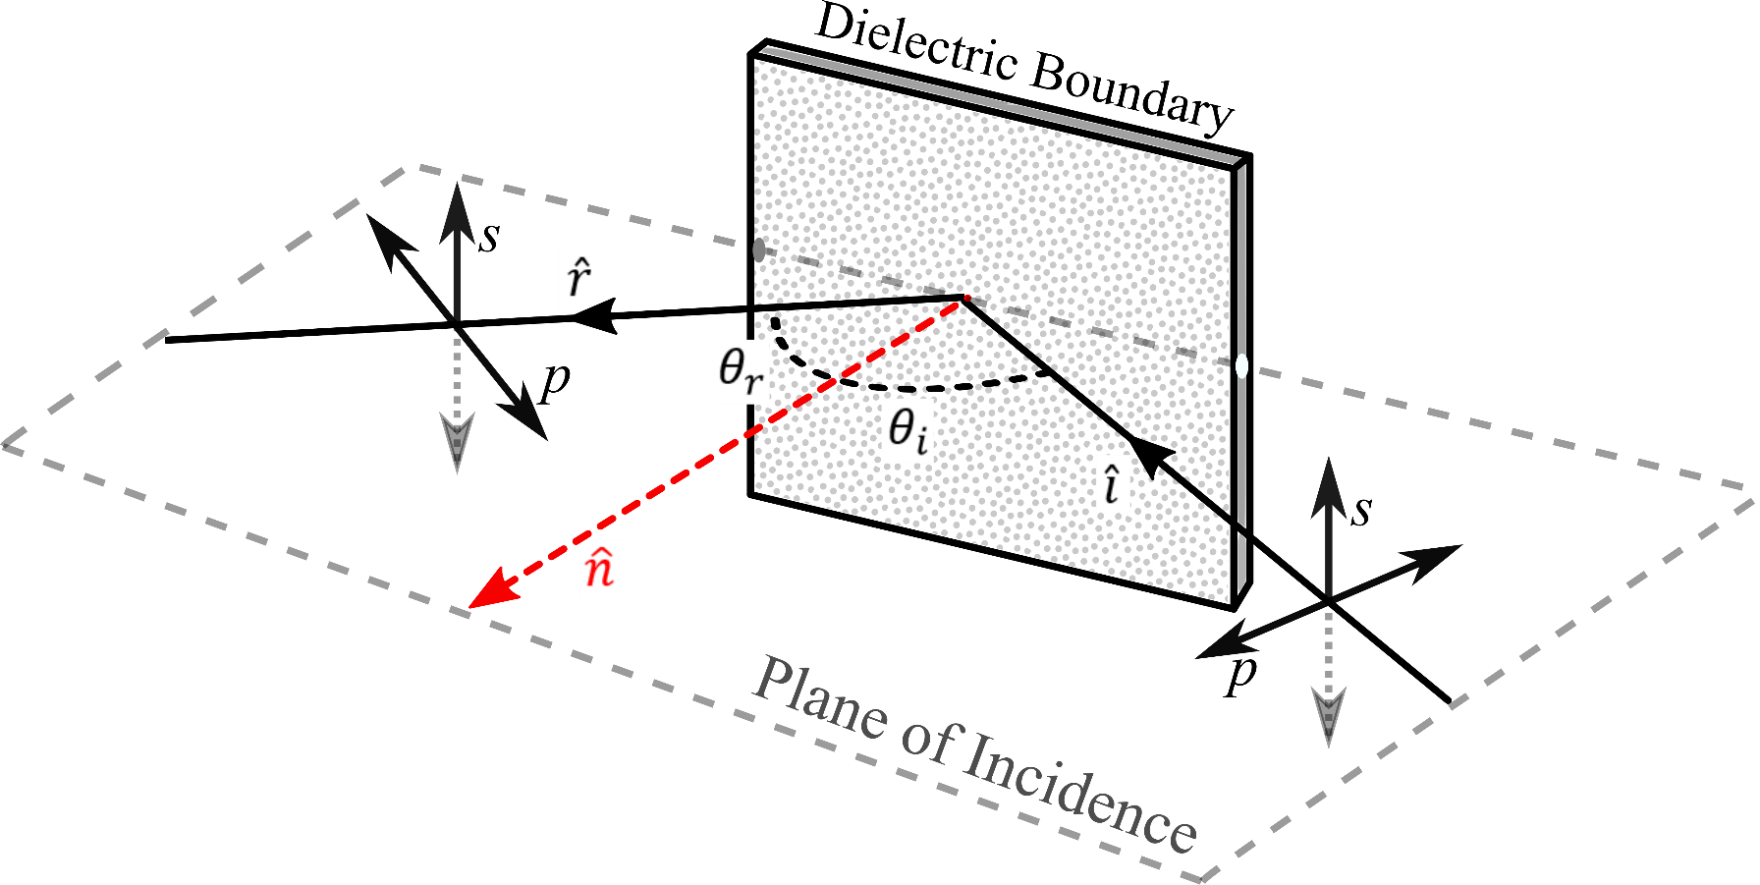
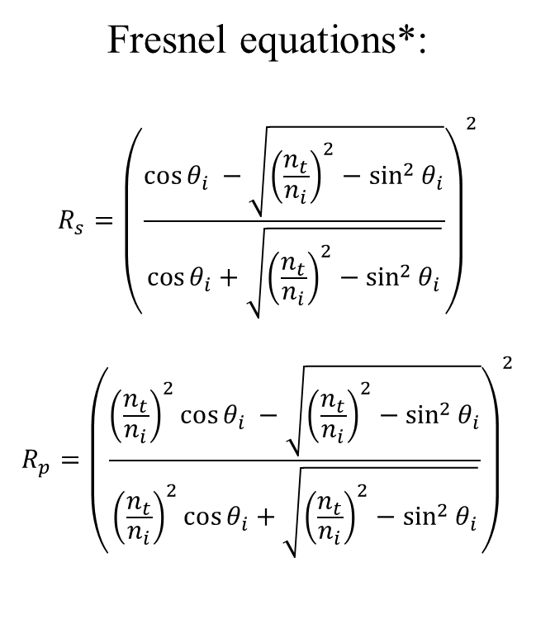
Specular reflection from a dielectric surface
Fresnel equations*:
$$R_{s}={\left(\frac{\cos{θ_{i} −\sqrt{{\left(\frac{n_{t}}{n_{i}}\right)}^{2}−\sin^{2}{θ_{i}}}}}{\cos{θ_{i}+\sqrt{{\left(\frac{n_{t}}{n_{i}}\right)}^{2}−\sin^{2}{θ_{i}}}}}\right)}^{2}$$
$$R_{p}={\left(\frac{{\left(\frac{n_{t}}{n_{i}}\right)}^{2}\cos{θ_{i} −\sqrt{{\left(\frac{n_{t}}{n_{i}}\right)}^{2}−\sin^{2}{θ_{i}}}}}{{\left(\frac{n_{t}}{n_{i}}\right)}^{2}\cos{θ_{i}+\sqrt{{\left(\frac{n_{t}}{n_{i}}\right)}^{2}−\sin^{2}{θ_{i}}}}}\right)}^{2}$$
* the Fresnel equations are not typically given in this form in the literature
Braunstein, vBFY, 7/29/2021

Slide 4
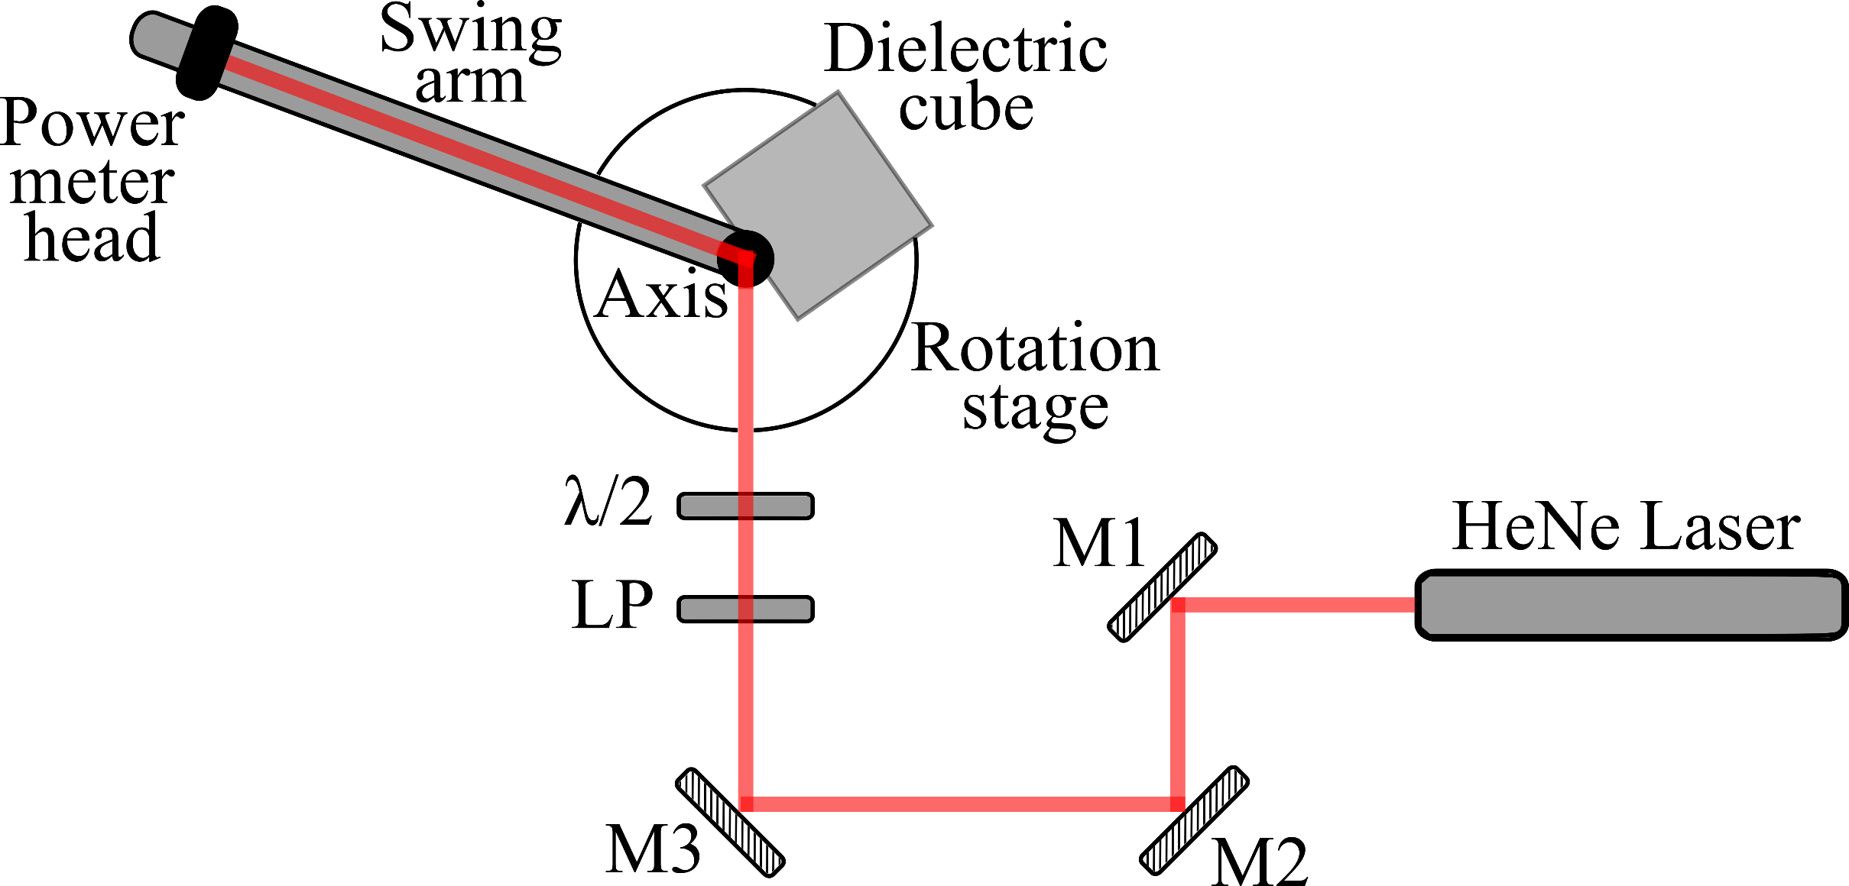
Apparatus
Mx: mirror
LP: linear polarizer
λ/2: half-wave plate
Braunstein, vBFY, 7/29/2021

Slide 5
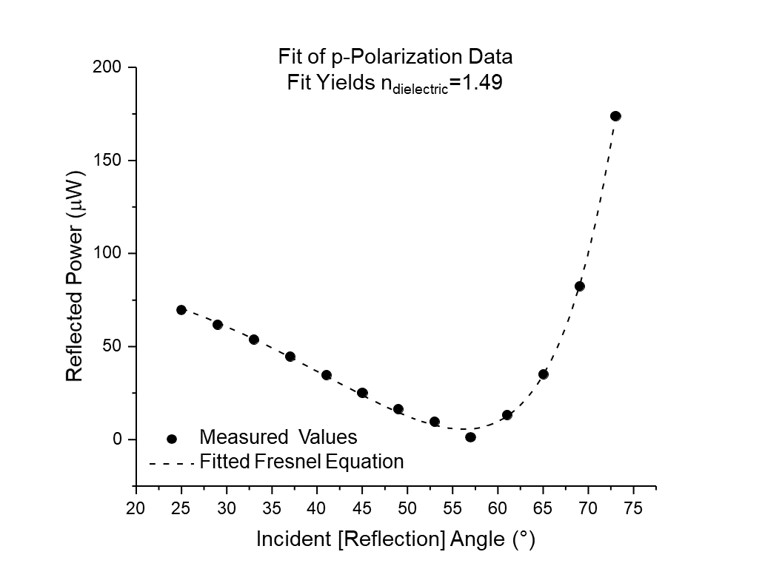
Example of results
Braunstein, vBFY, 7/29/2021

Slide 6
Student Tasks
Beam alignment
Qualitative investigation
Calibrate angle scale of rotation stage
Calibrate angle scale of λ/2 mount
Perform measurements corresponding to the Fresnel equations
Analyze the data
Braunstein, vBFY, 7/29/2021

Slide 7
Significance in the context of the Advanced Lab
Compelling and conceptually meaningful demonstration of and interaction with polarization
Optics lab skills (alignment)
Broad experimental methods challenges and experiences, including:
Angle calibrations
“Translation” of literature equations
Non-linear fitting
Immediate application of principles to other laboratory systems and practices
Presents meaningful context for addressing technical writing skills
Braunstein, vBFY, 7/29/2021

